Slide 1
Course Name: Database Management System
Course Code: CS116

Slide 2
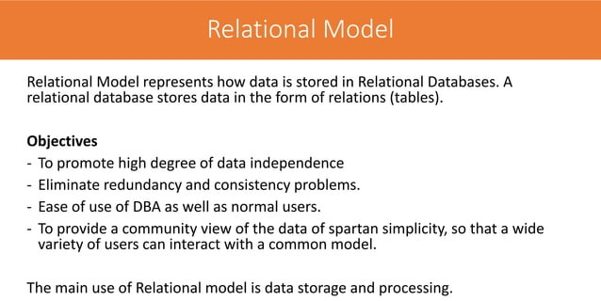

Slide 3
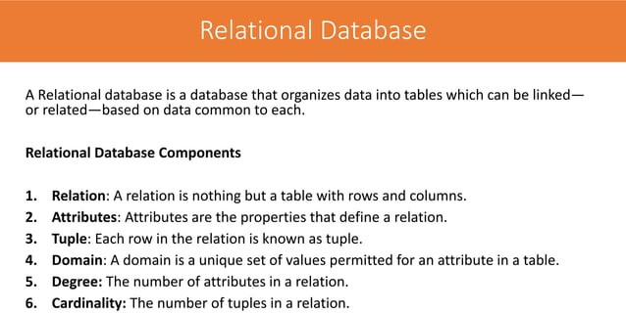

Slide 4
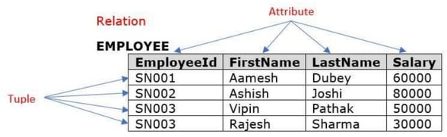

Slide 5
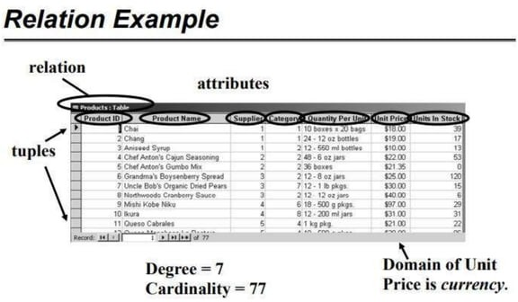

Slide 6
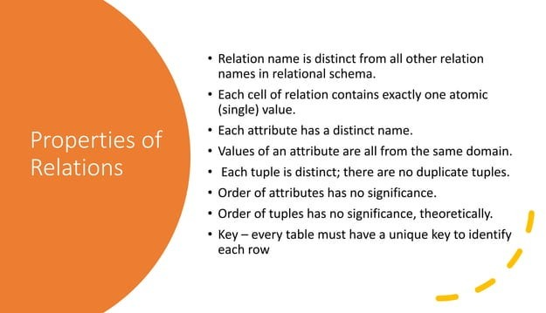

Slide 7
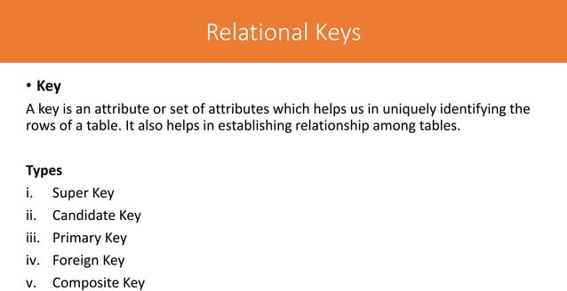

Slide 8
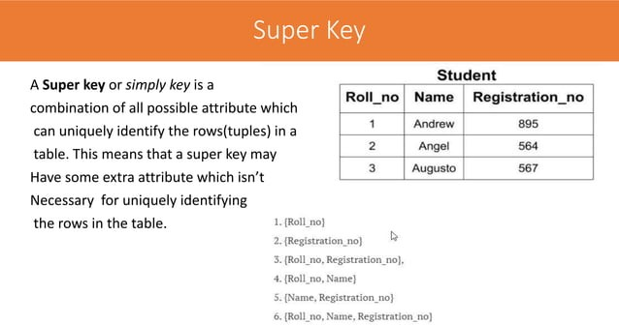
Super key superset of all combinations so we further make the candidate key or primary key from the super key.
A table can have many Super keys.

Slide 9
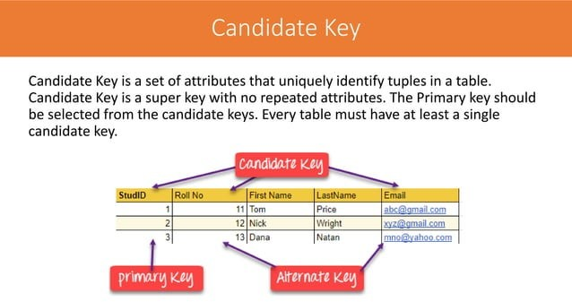

Slide 10
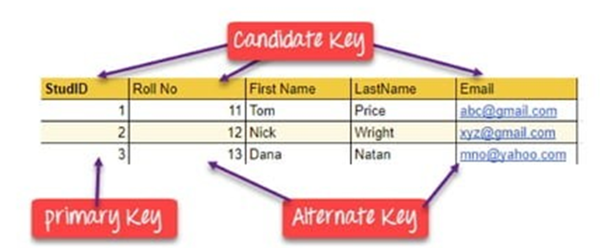
It is called a minimal super key because we select a candidate key from a set of super keys.
From the candidate key, we have to make the primary key.
{StudID) – This can be candidate key because it is uniquely identified.
{Roll No} -This can be a candidate key because it is uniquely identified.
{Email} - This can be a candidate key because it is uniquely identified.
{First Name} - This can’t be a candidate key because it is not uniquely identified.
{StudID, Roll No} -This can’t be a candidate key because it’s a minimal subset that will {StudID} and {Roll No}. As we know {StudID} already candidate key so the combination of this key is not eligible for the candidate key.
Final we have candidate key : {StudID},{Roll No} and {Email}

Slide 11
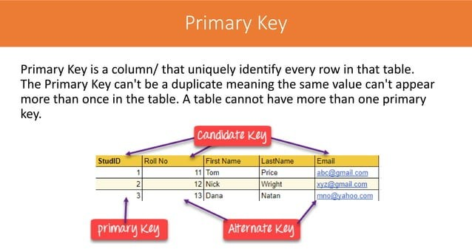

Slide 12
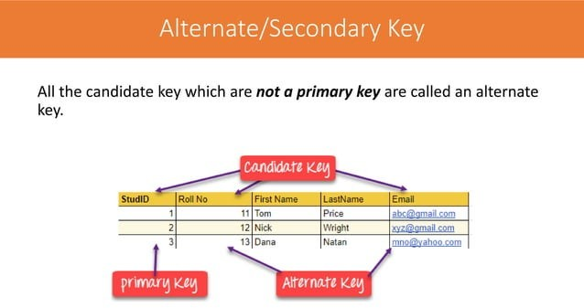

Slide 13
Final we have candidate key : {StudID}, {Roll No} and {Email}
Out of all the candidate keys, only one gets selected as the primary key, the remaining keys are known as alternate keys.
In this table:
{StudID} is best suited for the primary key.
The rest of attributes {Roll No} and {Email} are considered alternate keys
Final we have alternate keys : {Roll No} and {Email}

Slide 14
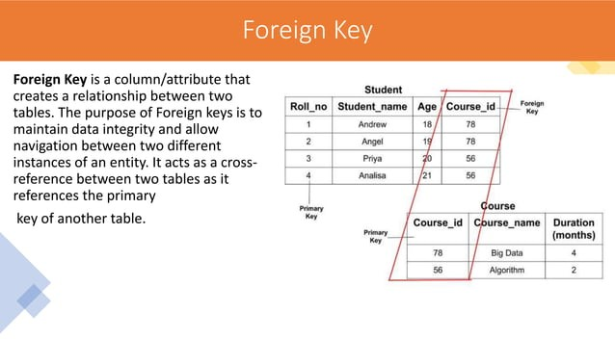

Slide 15
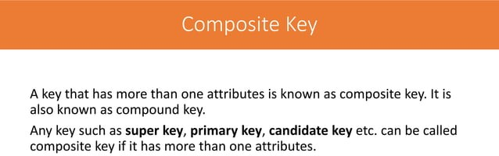

Slide 16
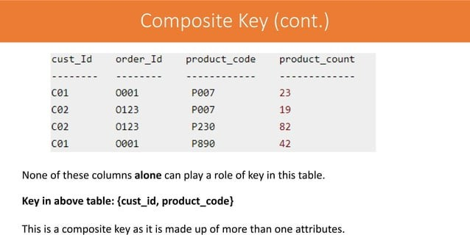

Slide 17
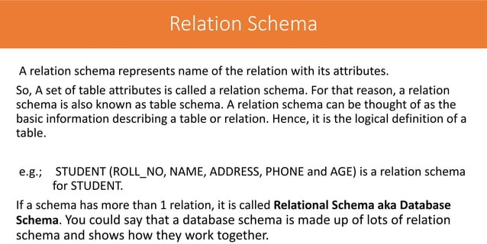

Slide 18
Integrity constraints
Integrity constraints in Database Management Systems (DBMS) are a set of rules that are applied on the table columns or relationships to ensure that the overall validity, integrity, and consistency (i.e. the quality) of the data present in the database table is maintained. Each and every time a table insert, update, delete, or alter operation is performed, it is evaluated against the terms or rules mentioned in the integrity constraint. The data is inserted, updated, deleted, or altered only if the result of the constraint comes out to be True. Thus, integrity constraint prevents accidental damage to the database by an authorized user.

Slide 19
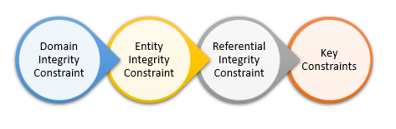
Types of Integrity Constraints in DBMS

Slide 20
Domain Integrity Constraint
A domain integrity constraint is a set of rules that restricts the kind of attributes or values a column or relation can hold in the database table. For example, we can specify if a particular column can hold null values or not, if the values have to be unique or not, the data type or size of values that can be entered in the column, the default values for the column, etc.
For example, we want to create a “customer_details” table, with information such as customer id, customer name, the number of items purchased, date of purchase, etc. So, in order to ensure domain integrity, we can specify the customer_id has to be unique, the quantity of items purchased has to be an integer number only and the date of purchase has to be a date or timestamp, etc.

Slide 21
Domain Integrity Constraint
CREATE TABLE customer_details
(
customer_id character varying(255) NOT NULL,
customer_name character varying(255) NOT NULL,
quantity integer NOT NULL,
date_purchased date
);

Slide 22
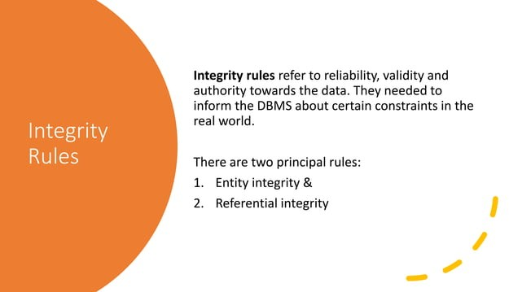

Slide 23
Entity Integrity Constraint
Entity Integrity Constraint is used to ensure the uniqueness of each record or row in the data table. There are primarily two types of integrity constraints that help us in ensuring the uniqueness of each row, namely, UNIQUE constraint and PRIMARY KEY constraint.
The unique key helps in uniquely identifying a record in the data table. It can be considered somewhat similar to the Primary key as both of them guarantee the uniqueness of a record. But unlike the primary key, a unique key can accept NULL values and it can be used on more than one column of the data table.

Slide 24
Entity Integrity Constraint
CREATE TABLE Students(
Student_ID number(5) NOT NULL,
Student_Name varchar(255) NOT NULL,
Class_Name varchar(255) UNIQUE,
Age int,
PRIMARY KEY (Student_ID)
);

Slide 25
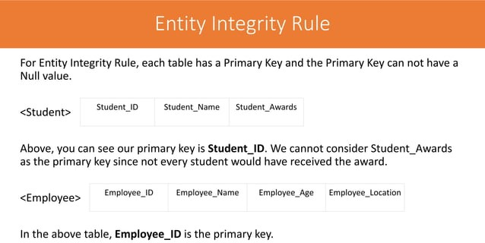

Slide 26
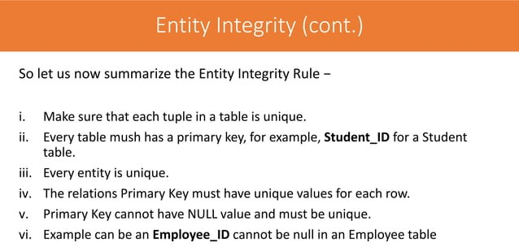

Slide 27
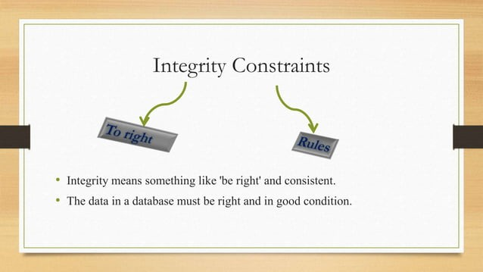

Slide 28
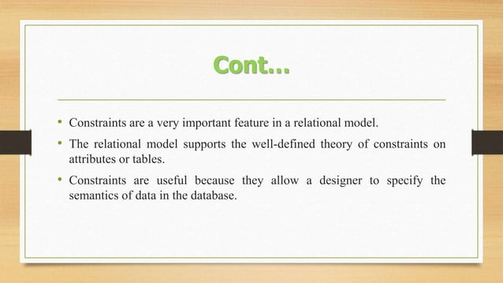

Slide 29
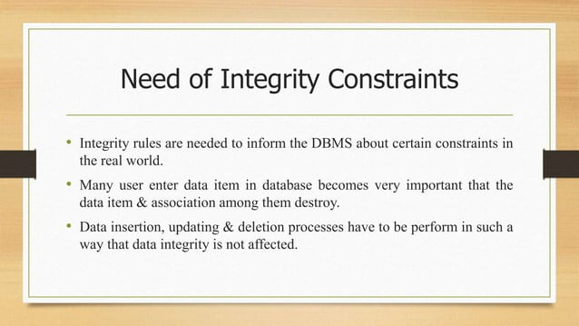

Slide 30
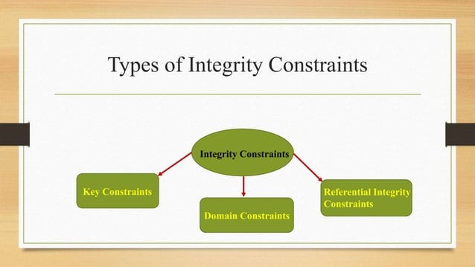

Slide 31
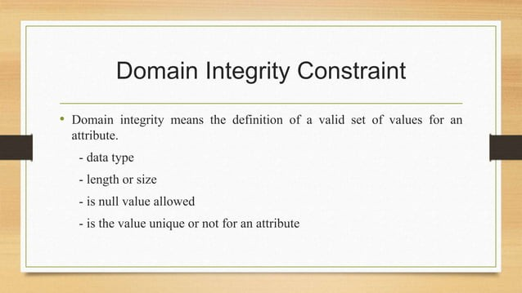

Slide 32
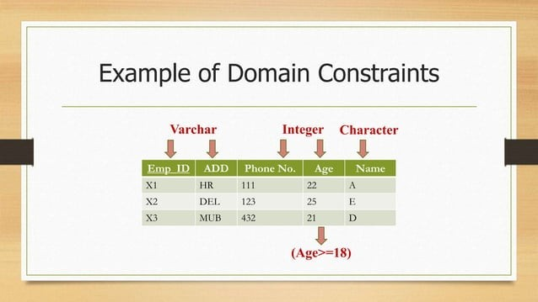

Slide 33
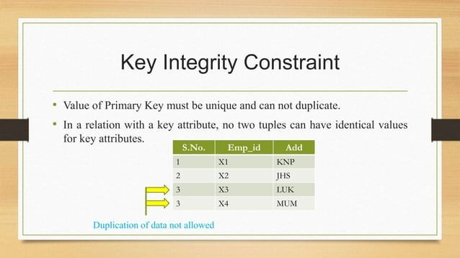

Slide 34
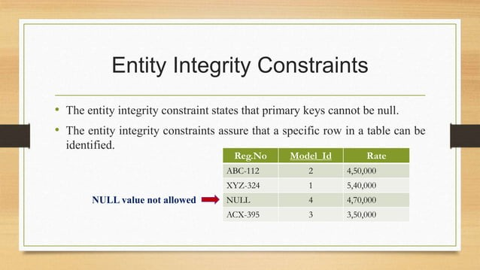

Slide 35
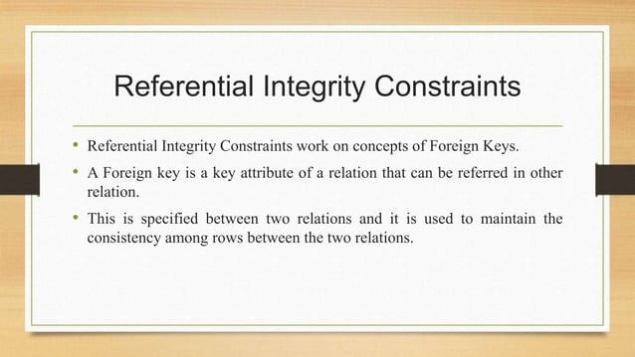

Slide 36
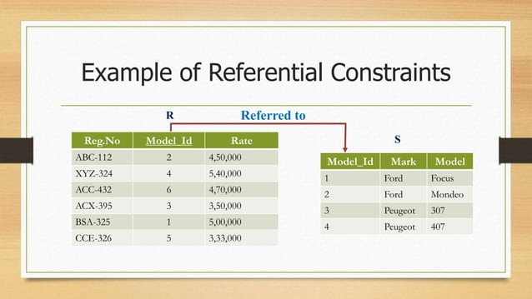

Slide 37
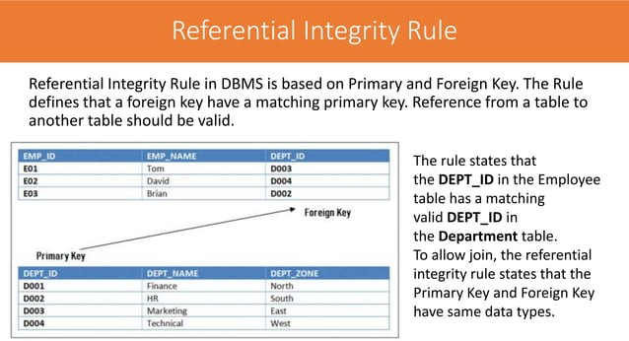

Slide 38
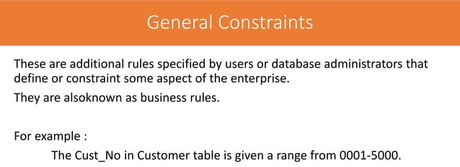

Slide 39
Key Constraints
There are a number of key constraints in SQL that ensure that an entity or record is uniquely or differently identified in the database. There can be more than one key in the table but it can have only one primary key.
Some of the key constraints in SQL are :
Primary Key Constraint
Foreign Key Constraint
Unique Key Constraint

Slide 40
Example
Table R1.
Let A,B,C,D,E are the attributes of this relation.
A→BCDE ( This means the attribute ‘A’ uniquely determines the other attributes B,C,D,E)
BC→ ADE (This means the attribute ‘BC’ jointly determines all the other attributes A,D,E in the relation.)
Find the following:
Primary Key
Candidate Key
Super Key
Composite Key
Table→R1
A
B
C
D
E

Slide 41
Output: Example
Primary Key: A
Candidate Key: A & BC
Super Key: A, BC, AE, AD, & ABC
Composite Key: BC

Slide 42


